Slide 1
Applied Cryptography
Public Key Cryptography

Slide 2
Learning Objectives
Upon completion of this unit, students will be able to
Explain how asymmetric (public key) encryption works.
Explain the difference between symmetric and asymmetric encryption and the need for public key cryptography.
Explain the use of key exchange/agreement protocols in cryptography.
Identify commonly used algorithms for asymmetric encryption.

Slide 3
Recall: Cryptography
Cryptography is “the practice and study of techniques for secure communication in the presence of adversaries” (Wikipedia)
It is the science of designing systems to store and transmit data in a secure way so that it preserves its integrity and is accessible to only those with proper authentication and authorization.
Notes:
“Cryptography." Wikipedia: The Free Encyclopedia. Wikimedia Foundation, Inc. 30 Nov 2016. <https://en.wikipedia.org/wiki/Cryptography>.

Slide 4
Recall: Cryptography and the Main Tenets of Information Security
Confidentiality
Encryption algorithms
Integrity
Hash functions
Authenticity
Digital signatures, digital certificates
Non-repudiation
Digital signatures, digital certificates

Slide 5
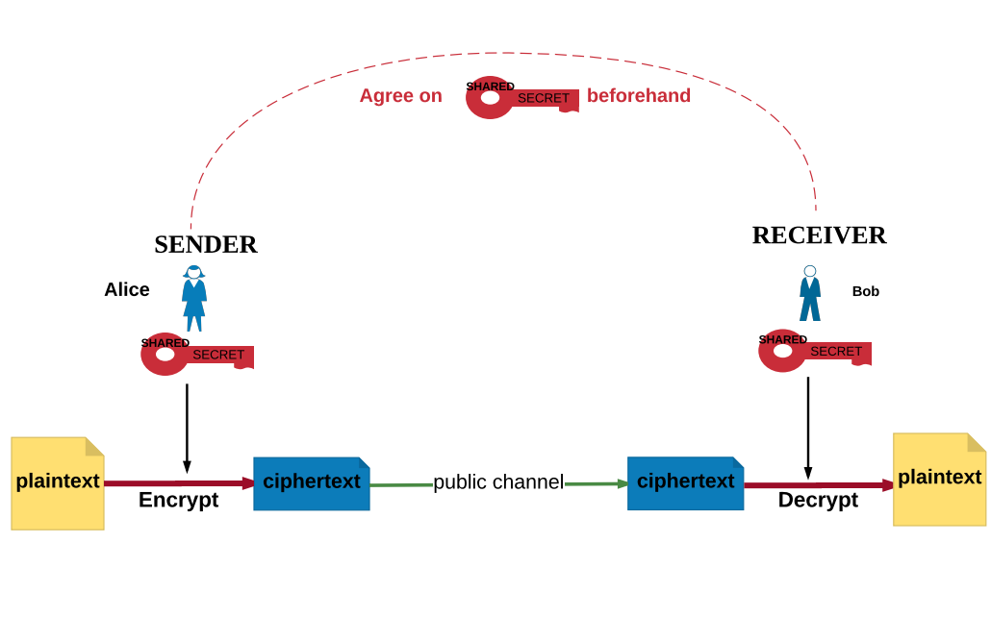
Recall: Symmetric Key Cryptography
“Symmetric Encryption" by Yesem Kurt-Peker licensed under CC BY 4.0
Notes:
The distinguishing feature of symmetric key cryptography is the use of the same key for encryption and decryption. Note the illustrations of plaintext, ciphertext, and key on the slide.

Slide 6
Recall Problem of Key Distribution and Management
Modern symmetric key algorithms are great! They are fast and secure when implemented correctly and keys are chosen properly.
Problem: How to get the keys to the two parties?
Need a secure channel – a channel that makes it very difficult for the adversary to access the actual plaintext that is being transmitted.
But the Internet is not secure!
Solution: Public Key Cryptography
Notes:
Examples of a secure channel could be a trusted carrier carrying and delivering the key in a locked case or an untapped phone line which the two parties use to agree what the key will be.

Slide 7
Public Key Cryptography
Each user has a public and a private key.
Public keys are published.
Private keys are secret. (Only one party, the owner, knows the private key, NOT both parties!)

Slide 8
Solutions for Key Distribution
Public Key Encryption:
Encrypt the shared secret key for symmetric ciphers using asymmetric (public key) encryption and send over the (not secure) channel.
Key Agreement Algorithms:
Use public and private keys to agree on a key without exchanging any private information.

Slide 9
1. Asymmetric Encryption/Decryption
If Alice wants to send Bob a confidential message, she gets Bob’s public key.
She encrypts her message to Bob using Bob’s public key and sends it to Bob (possibly over the Internet).
Bob, upon receipt of the encrypted message from Alice, uses his private key to decrypt the message.
Because only Bob knows his private key, only he can decrypt the message and read it!

Slide 10
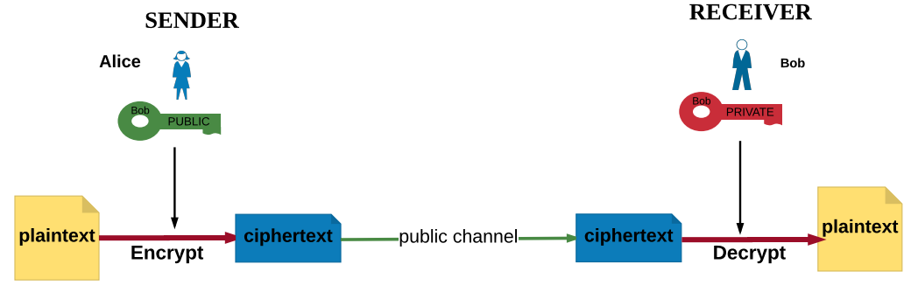
Asymmetric Encryption
“Asymmetric Encryption" by Yesem Kurt-Peker licensed under CC BY 4.0
Note that no communication is necessary beforehand to agree on a shared secret key.
Notes:
Sender= Alice
Recipient= Bob
Contrast this with the Symmetric Key diagram.

Slide 11
Advantage of Asymmetric Encryption
With asymmetric encryption, users do not have to share a secret value that they have to communicate or agree on beforehand or over a public channel.
Public keys are published and available to everyone in the system.
NOTE: Private keys should NOT be shared!

Slide 12
Examples of Asymmetric Encryption Algorithms
RSA Encryption
Developed by Rivest, Shamir, Adleman (scientists at Berkley) in 1976
Included in the cipher suite for key agreement/exchange in TLS/SSL (Transport Layer Security/Secure Socket Layer)
Elliptic Curve Encryption
Suggested independently by N. Koblitz and V. Miller in 1985
Included in the cipher suite for key agreement / exchange in TLS/SSL (https://en.wikipedia.org/wiki/Cipher_suite)
Also included in Bluetooth Low Energy (LE) protocols
Notes:
These algorithms are used to encrypt the values (possibly keys) that need to be shared between two users who want to communicate privately over a public channel. The parties do not encrypt/decrypt all messages using these algorithms (that would be too expensive time-wise), but just some secret values that are used to set up keys or are themselves secret keys.

Slide 13
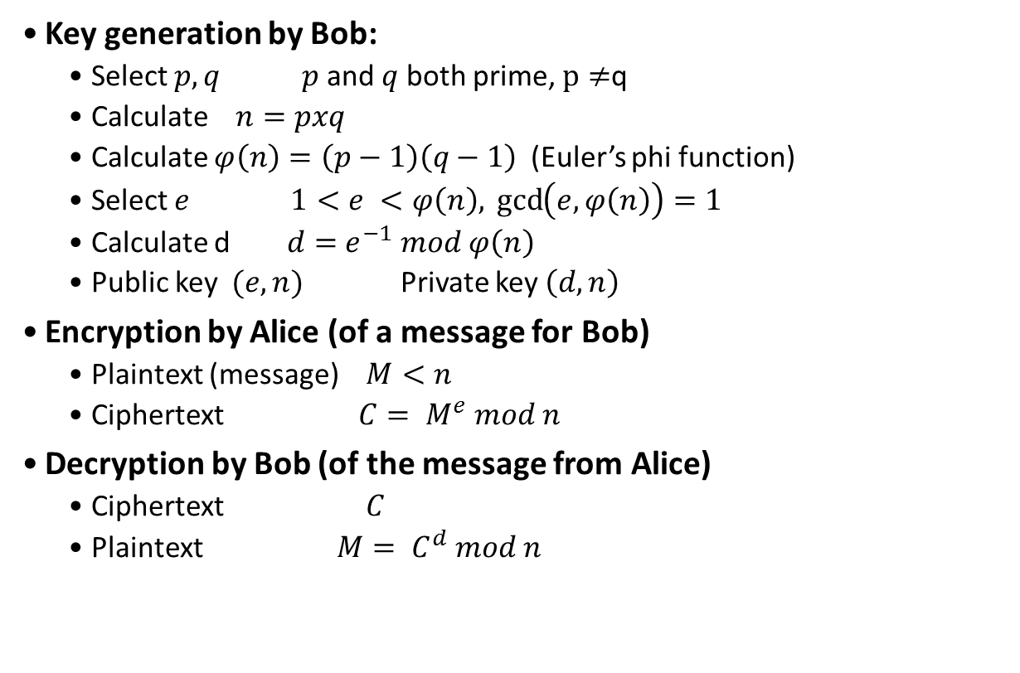
A Glimpse of the RSA Encryption
Key generation by Bob:
Select $p,q$ $p$ and $q$ both prime, $p≠$q
Calculate $n=pxq$
Calculate $φ\left(n\right)=\left(p−1\right)\left(q−1\right)$ (Euler’s phi function)
Select $e$ $1<e <φ\left(n\right),\gcd\left(e,φ\left(n\right)\right)=1$
Calculate d $d=$ $e^{−1}$ $mod$ $φ\left(n\right)$
Public key $(e,n)$Private key $\left(d,n\right)$
Encryption by Alice (of a message for Bob)
Plaintext (message) $M<n$
Ciphertext $C= M^{e} mod n$
Decryption by Bob (of the message from Alice)
Ciphertext $C$
Plaintext $M= C^{d} mod n$
Notes:
Note the math involved in this algorithm. Students are not expected to understand what this math means. Although it’s not required, this algorithm can be contrasted with the slides that show DES or AES algorithms (from Unit 1) to show how math is involvement in public key algorithms.

Slide 14
One Problem: Authentication
How does Bob know that the message is indeed from Alice?
Someone else might have used Bob’s public key, sent him the message, and claimed he/she was Alice!
Solution: Digital signatures and certificates

Slide 15
2. Key Agreement (Exchange) Protocols
Public Key Cryptography gives us another way to communicate privately without having to share secret information prior to the communication.
Purpose is to enable two users to securely agree on a key that can then be used for subsequent symmetric encryption of messages.

Slide 16
Key Agreement Protocols
Alice and Bob both have public and private keys.
These keys are chosen so that Alice and Bob can compute the same number using their own private key and the other’s public key.
This key that they compute is very hard to find without the knowledge of one of the private keys or with the knowledge of both the public keys.
Notes:
Note that no data is exchanged between the two parties except for the public keys before agreeing on a key.

Slide 17
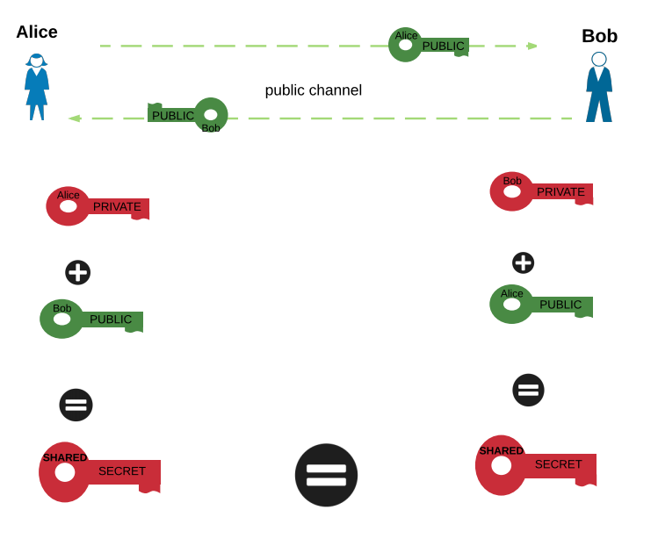
Key Agreement
“Key Agreement" by Yesem Kurt-Peker licensed under CC BY 4.0
Notes:
The parties who want to agree on a shared secret first exchange their public keys. Then, using their own private key and the other party’s public key, they calculate a value. The result of this calculation at both ends is the shared secret. The fact that they both calculate the same value is achieved by the mathematics used in the scheme.

Slide 18
Examples of Key Agreement Schemes
Diffie-Hellman Key Agreement (DH)
First public key algorithm (1976)
Developed by Diffie and Hellman and Merkle independently
Included in the cipher suite for key agreement/exchange in TLS/SSL and Bluetooth Low Energy (LE) protocols
Elliptic Curve Diffie-Hellman Key Agreement (1985)
Same idea as DH but works on elliptic curves
Included in the cipher suite for key agreement/exchange in TLS/SSL and Bluetooth (LE) protocols

Slide 19
Use of Key Agreement Protocols
Users could create random private/public keys each time they communicate
OR
Users could create private and public keys and publish the public key
Problem: Vulnerable to Man-in-the-Middle-Attack
Notes:
Now consider a simple protocol that makes use of the Diffie-Hellman calculation. Suppose that user A wishes to set up a connection with user B and use a secret key to encrypt messages on that connection. User A can generate a one-time private key X_{A}, calculate Y_{A}, and send that to user B. User B responds by generating a private value X_{B}, calculating Y_{B}, and sending Y_{B} to user A. Both users can now calculate the key. The necessary public values q and a would need to be known ahead of time. Alternatively, user A could pick values for q and a and include those in the first message.

Slide 20
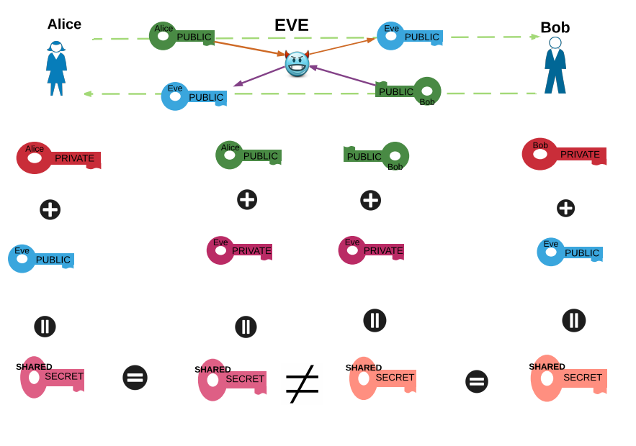
Man in the Middle (MITM) Attack
“Man in the Middle Attack" by Yesem Kurt-Peker licensed under CC BY 4.0
Notes:
In this diagram, Alice and Bob want to agree on a key. They first share their public keys. This is where the evil Man-in-the-Middle, EVE, comes into the picture. She intercepts Alice’s public key and sends Bob her own public key instead. She also intercepts Bob’s public key and sends Alice her own public key.
Now Alice and Bob both calculate keys using the public keys they receive and their own private keys. They think they are calculating the same key as one another but indeed what they calculate can only be calculated by Eve. Eve calculates the two keys, one with Alice’s public key and one with Bob’s public key, and communicates with Bob as if she is Alice and communicates with Alice as if she is Bob. Alice and Bob have no idea that their messages are read by and possibly modified by Eve.
The key exchange protocol is vulnerable to such an attack because it does not authenticate the participants. This vulnerability can be overcome with the use of digital signatures and public key certificates.

Slide 21
Another Problem: Integrity
How does Bob know that the message was not altered on the way (in transit)?
Even if Bob is able to authenticate that the message is from Alice, it may be that someone altered the message on the way and then put the signature back on it. How can he avoid this?
Solution: Hash functions

